Slide 1
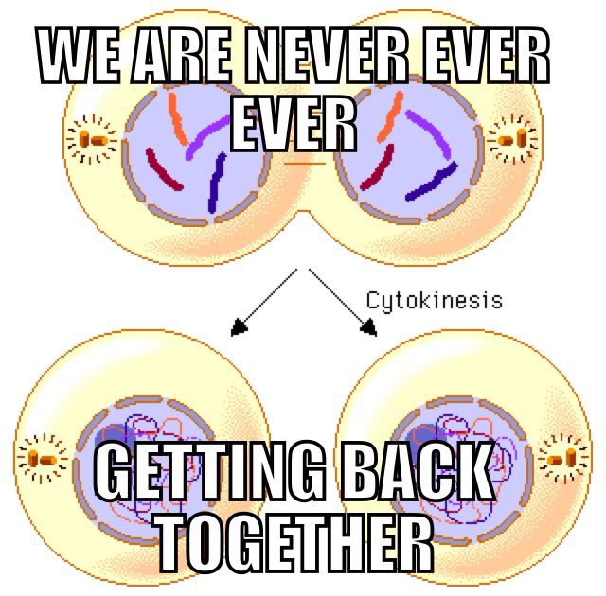
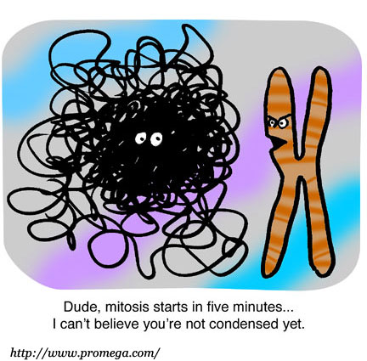
Mitosis and Meiosis

Slide 2
A series of events that lead to cell growth and division is called the _______________.

Slide 3
Answers
Cell Cycle

Slide 4
Place the following steps in the cell cycle into the order in which they occur:
I – M Phase
II – G2
III – S
IV – G1

Slide 5
Answers
G1, S, G2, M Phase (IV, III, II, I)

Slide 6
If the number of chromosomes in a cloned sheep skin cell is 82, how many chromosomes would be found in the sheep’s normal sperm cell?

Slide 7
Answers
41 Chromosomes

Slide 8
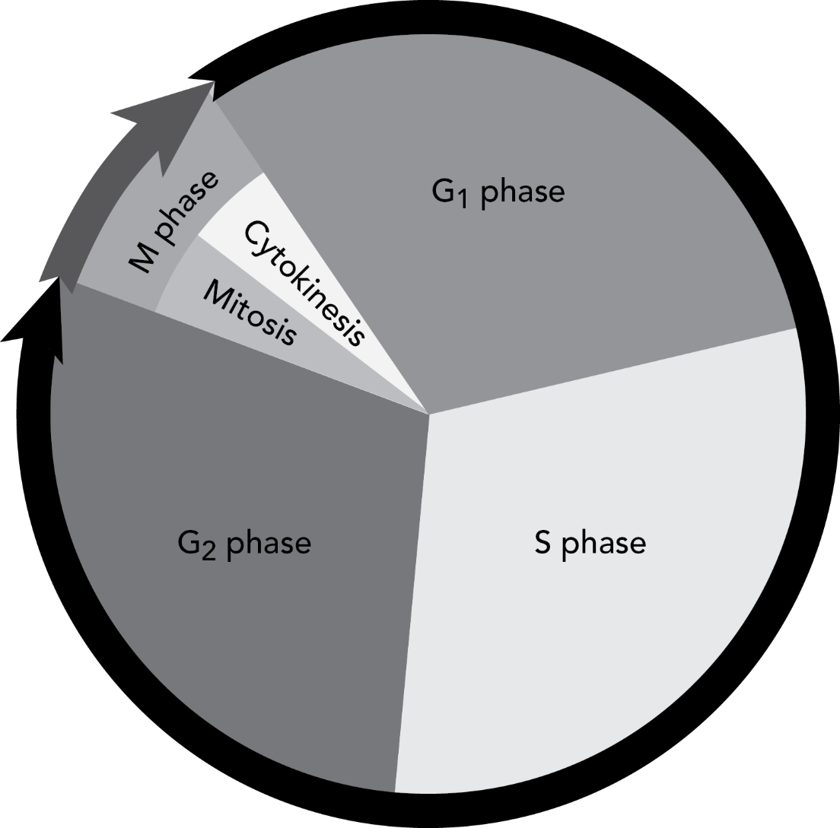
This diagram models the processes that take place during the Cell Cycle
What is taking place
in the S Phase?

Slide 9
Answers
DNA Replication

Slide 10
What must a cell do before it can divide?

Slide 11
Answers
Grow bigger
Replicate its DNA

Slide 12
How many chromosomes should be in the daughter cells?
68

Slide 13
Answers
34.
They would be Different!

Slide 14
What is the purpose of Mitosis?

Slide 15
Answers
Cell growth and division

Slide 16
What type of cells undergo Mitosis?

Slide 17
Answers
Somatic Cells (body cells)

Slide 18
Do cells preparing for mitosis undergo the cell cycle?
Why/Why not?

Slide 19
Answers
YES! They must grow and replicate their genetic information (DNA)

Slide 20
Mitotic division results in ______________ daughter cells.

Slide 21
Answers
2 diploid, identical

Slide 22
Do the daughter cells created during Mitosis have less, the same, or more genetic information than the parent cell?

Slide 23
Answers
The same amount of genetic information.
They are IDENTICAL to the parent cell, and each other
They have the EXACT SAME chromosomes!

Slide 24
Mitosis or Meiosis?

Slide 25
Answers
Mitosis

Slide 26
What is the purpose of Meiosis?

Slide 27
Answer
Creation of gametes

Slide 28
What type of cells undergo Meiosis?

Slide 29
Answer
Germ Cells (sex cells)

Slide 30
Do cells preparing for meiosis undergo the cell cycle?
Why/Why not?

Slide 31
Answers
YES! They must grow and replicate their genetic information (DNA)

Slide 32
How many chromosomes should be in the daughter cells?
74

Slide 33
Answers
74.
They would have the exact same chromosomes as the parent cell (Identical/Clones)

Slide 34
Meiotic division results in ____________________ daughter cells.

Slide 35
Answer
4 haploid, different

Slide 36
Do the daughter cells created during Meiosis have less, the same, or more genetic information than the parent cell?

Slide 37
Answers
Less amount of genetic information.
They are HAPLOID. They only have half of the information they parent cell has.

Slide 38
Does Meiosis contribute to Genetic Continuity?

Slide 39
Answers
YES!

Slide 40
If the number of chromosomes in a cloned sheep skin cell is 82, how many chromosomes were in the cell used to clone it?

Slide 41
Answers
82 Chormosomes.
IDENTICAL - Mitosis

Slide 42
Does Meiosis contribute to Genetic Variation?

Slide 43
Answers
YES!

Slide 44
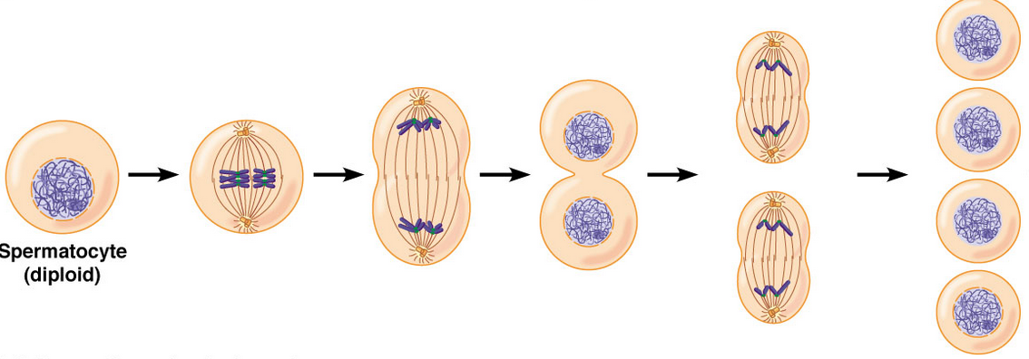
Mitosis or Meiosis?

Slide 45
Answers
Meiosis

Slide 46
What are gametes?

Slide 47
Answer
Eggs and Sperm

Slide 48
What do gametes combine to create?

Slide 49
Answer
A zygote (a baby!)

Slide 50
What is the term used for the shuffling of genetic information that is seen in Prophase I?

Slide 51
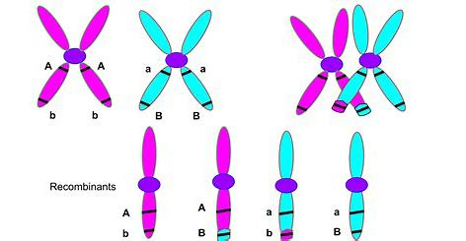
Answers
Crossing over

Slide 52
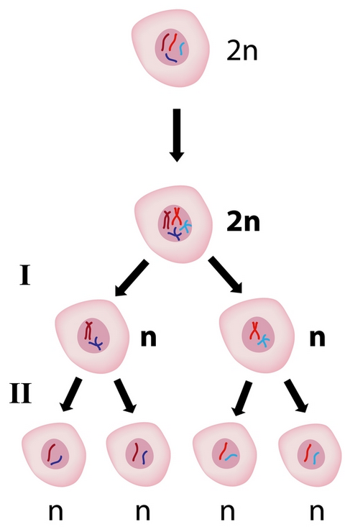
Mitosis or Meiosis?

Slide 53
Answers
Meiosis

Slide 54
Which would be more genetically similar to each other, 2 somatic cells from the same lady, or 2 gametes from the same lady?

Slide 55
Answers
2 Somatic cells from the same lady

Slide 56
What happens when Mitotic division goes wrong?

Slide 57
Answers
Cancer!
Uncontrolled Cellular Division

Slide 58
What happens when Meiotic division goes wrong?

Slide 59
Answers
Nondisjunction!
Uneven dividing of chromosomes during separation.
Ex: Trisomy 21 (Down’s Syndrome)

Slide 60
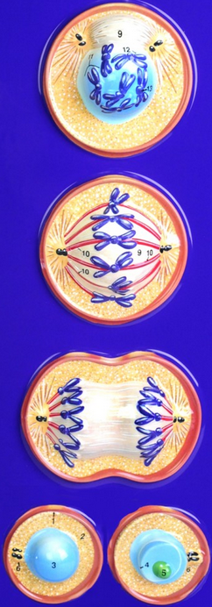
Mitosis or Meiosis?

Slide 61
Answers
Mitosis

