Slide 1
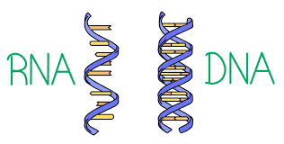
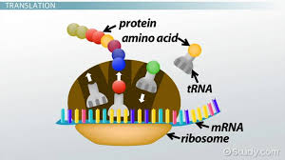
DNA RNA DNA Replication transcription & Translation (Oh my!)

Slide 2
What are the 4 nucleotide bases of DNA?

Slide 3
Answers
Adenine
Thymine
Cytosine
Guanine

Slide 4
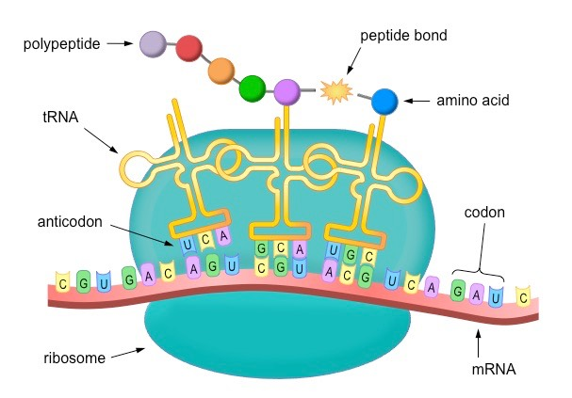
Which process is occurring?

Slide 5
Answers
Translation

Slide 6
What does helicase do?

Slide 7
Answers
It unzips the DNA strands so replication or transcription can occur
Breaks hydrogen bonds between nitrogen bases

Slide 8
What are the 4 nucleotide bases found in RNA?

Slide 9
Answers
Adenine
Uracil
Cytosine
Guanine

Slide 10
A section of DNA has the following nitrogenous bases:
AGCTGAAAT
What would be the complementary base pairing for DNA Replication?

Slide 11
Answers
AGCTGAAAT
TCGACTTTA

Slide 12
What are the 3 main structural differences between DNA and RNA?
(How can you tell them apart?)

Slide 13
Answers
DNA – 2 strands RNA – 1 strand
DNA – Deoxyribose RNA – Ribose
DNA – Thymine RNA - Uracil

Slide 14
Where does each process occur?
DNA Replication
Transcription
Translation

Slide 15
Answers
Replication – Nucleus
Transcription – Nucleus
Translation – Ribosome in the Cytoplasm

Slide 16
What are the building blocks (monomers) of nucleic acids?

Slide 17
Answers
Nucleotides

Slide 18
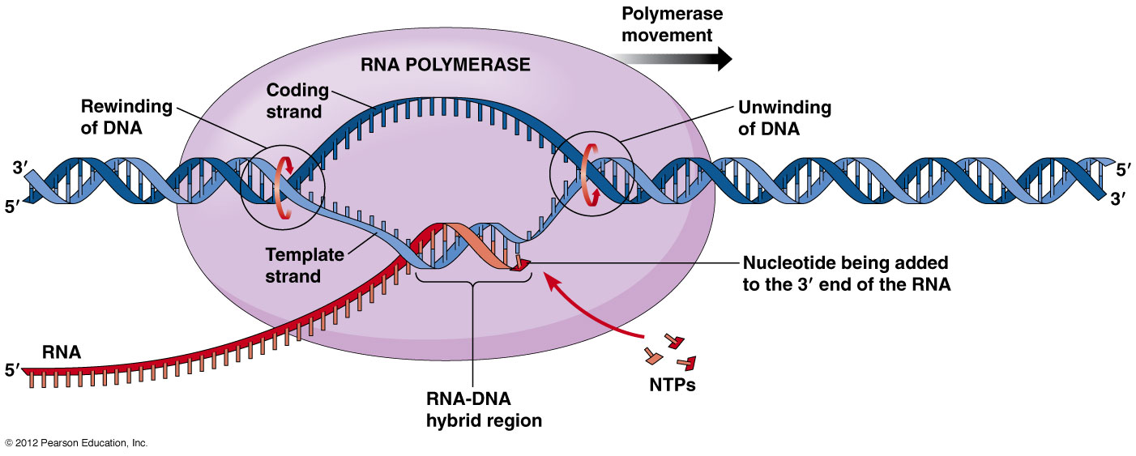
Which process is occurring?

Slide 19
Answers
Transcription

Slide 20
What are the 3 parts of the nucleotide?

Slide 21
Answers
Sugar, Phosphate, and a nitrogenous base

Slide 22
What part(s) of the nucleotide make up the backbone/sides of the DNA molecule?

Slide 23
Answers
Sugar and Phosphate

Slide 24
If a DNA molecule is found to be composed of 20% guanine, what percentage of cytosine would be expected?

Slide 25
Answers
20%

Slide 26
What part(s) of the nucleotide make up the “rungs” of the DNA molecule, and how are they held together?

Slide 27
Answer
Nitrogenous bases held together by hydrogen bonds.

Slide 28
What is the function of mRNA?

Slide 29
Answer
Brings the genetic information out of the nucleus and to the ribosome.

Slide 30
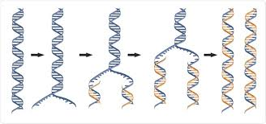
What process is this?

Slide 31
Answers
DNA replication

Slide 32
If a DNA molecule is found to be composed of 22% adenine, what percentage of cytosine would be expected?

Slide 33
Answer
28%

Slide 34
What is the function of rRNA?

Slide 35
Answers
Makes up the Ribosome that is used to create proteins.

Slide 36
A section of DNA has the following nitrogenous bases:
AGCTGAAAT
What would be the complementary base pairing for Transcription?

Slide 37
Answer
AGCTGAAAT
UCGACUUUA

Slide 38
Using this DNA sequence for transcription and translation into the proper amino acids (you need your amino acid chart!).
ATGCTA

Slide 39
Answer
DNA - ATGCTA
RNA - UAC GAU
Amino Acid - Tyr, Asp

Slide 40
What are the building blocks (monomers) of proteins?

Slide 41
Answers
Amino Acids

Slide 42
What is the function of tRNA?

Slide 43
Answers
Brings the amino acids to the ribosome to create a protein

