Slide 1
GENETICS UNIT TASK CARDS Grades 7-10

Slide 2
1
Different versions of a single gene are called ______________, and one can be dominant over the other(s).

Slide 3
2
Describe “genotype” and “phenotype” in your own words.
How are the two terms related?

Slide 4
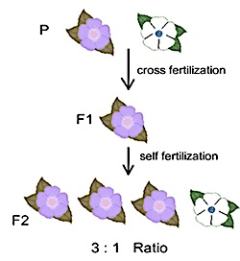
3
Draw a Punnett square depicting the cross of the F1 generation of Mendel’s pea plant experiments.

Slide 5
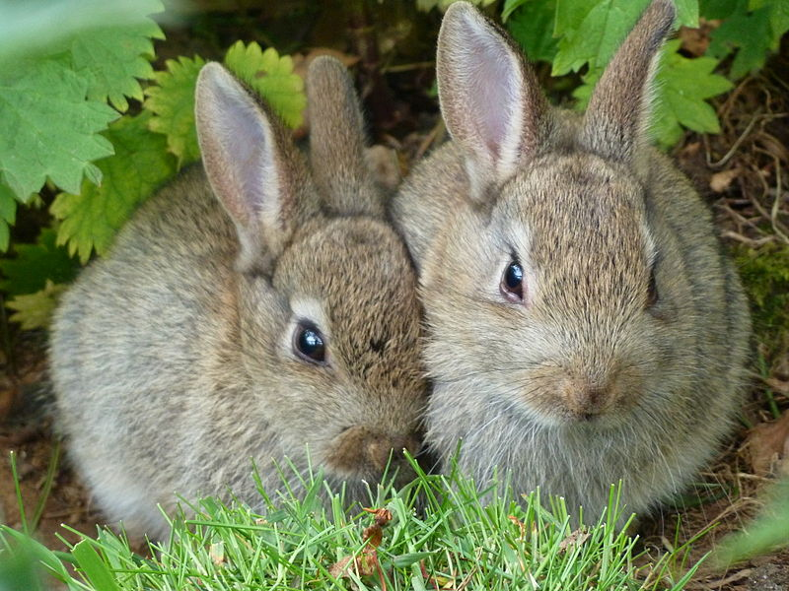
4
In Rabbits, the allele B for black hair is dominant over the allele b for brown hair.
Calculate the probability of homozygous dominant offspring resulting from a cross between two heterozygous parents.

Slide 6
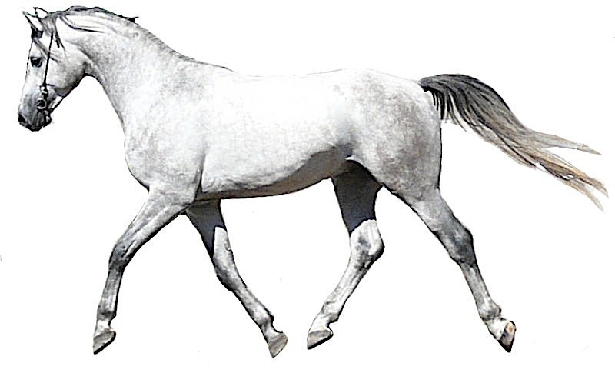
5
In horses, the allele C for a chestnut coat is is dominant to the allele c a gray coat. Calculate the probability of heterozygous offspring resulting from a cross between a heterozygous parent and a homozygous recessive parent.

Slide 7
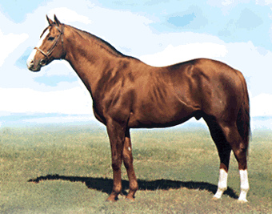
6
In horses, the allele C for a chestnut coat is is dominant to the allele c a gray coat. A heterozygous stallion and a heterozygous mare have produced three chestnut foals. What is the chance that their next foal will also be chestnut?

Slide 8
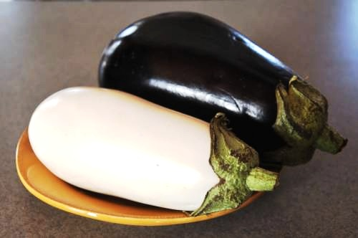
7
In eggplant, the allele P for purple eggplants are dominant over the allele p for white eggplants.
Calculate the probability of heterozygous offspring resulting from a cross between a homozygous dominant parent and a homozygous recessive parent.

Slide 9
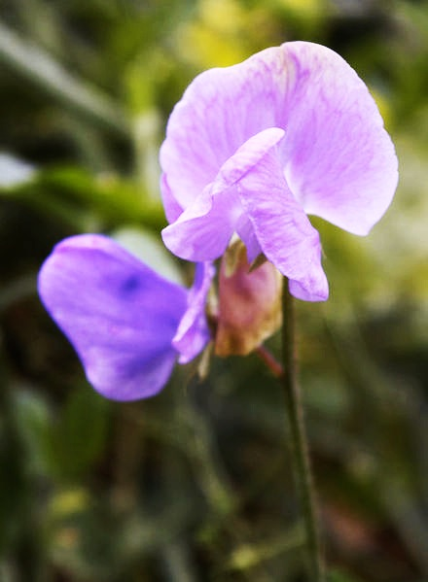
8
In pea plants, the allele T for tall pea plants is dominant to the allele t for short plants.
Calculate the probability of homozygous dominant offspring from a cross between a heterozygous parent and a homozygous recessive parent.
Show Your Work With a Punnett Square!

Slide 10
9
If a brown-eyed woman’s father has blue eyes, and her mother has brown eyes, she is most likely _____________[homozygous | heterozygous] for the eye color trait.

Slide 11
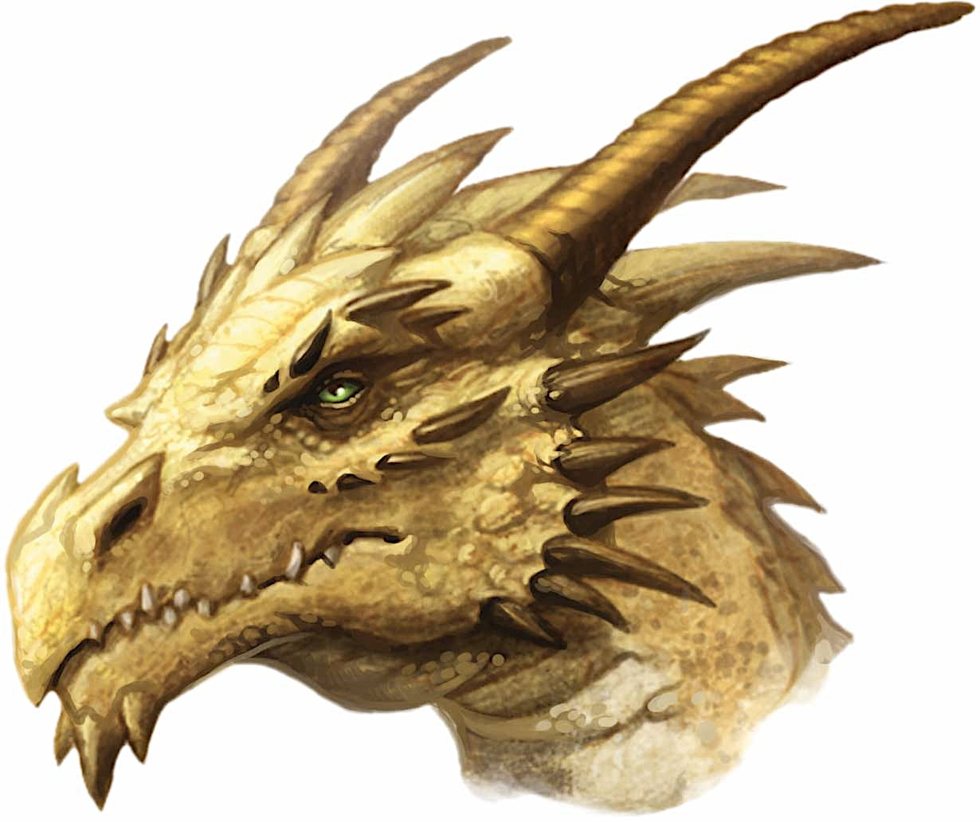
10
In dragons, yellow eyes are dominant to green eyes. Two yellow-eyed dragons mate, and produce three eggs. Of the three hatchlings, one has green eyes.
What are the genotypes of the parent dragons?

Slide 12
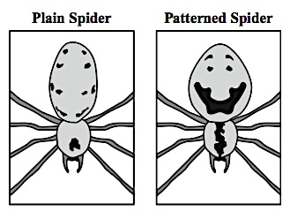
11
In Hawaiian Happy Face Spiders, the patterned allele is dominant to the plain allele.
A plain spider is crossed with a patterned spider. The patterned spider is heterozygous.
Which genotypes are produced among the offspring and in what ratio?
Which phenotypes are produced and in what ratio?

Slide 13
12
In Hawaiian Happy Face Spiders, the patterned allele is dominant and the plain allele is recessive.
Two patterned heterozygous spiders are crossed.
600 offspring are produced.
How many of them are plain?

Slide 14
13
Which of Mendel’s Laws states that the members of each pair of alleles separate when gametes are formed?
Tt
T
t

Slide 15
14
Which Mendel’s Law states that two or more pairs of alleles segregate independently of one another during gamete formation, creating at least four different outcomes?
Aa
Bb
A
B
A
b
a
B
a
b

Slide 16
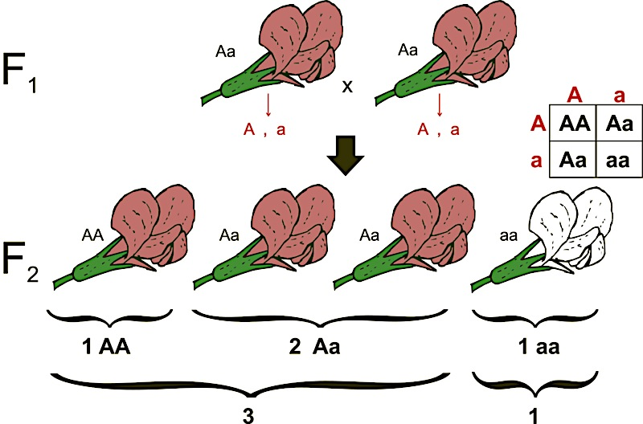
15
Which of Mendel’s laws does this illustration represent?

Slide 17
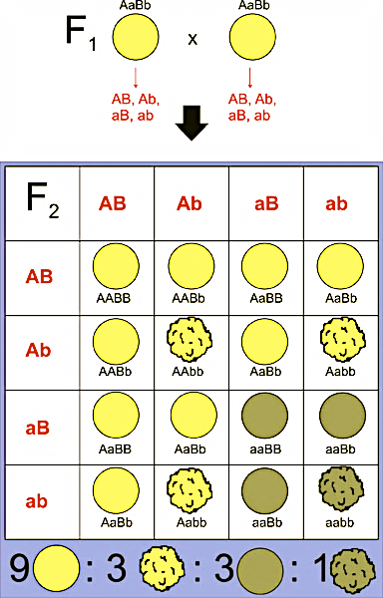
16
Which of Mendel’s laws does this illustration represent?

Slide 18
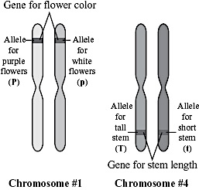
17
The diagram shows the positions of the genes for flower color and stem length in a pea plant. The chromosomes represented below will replicate before meiosis.
For these two genes, what is the maximum number of different allele combinations that can be formed normally in gametes produced from this cell?

Slide 19
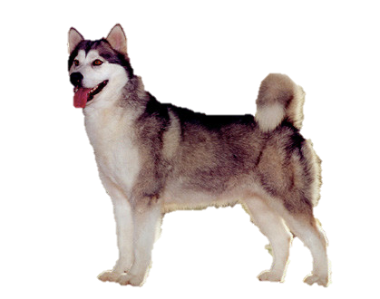
18
In Alaskan malamutes, the dwarf allele is recessive (d), while the normal allele is dominant (D). Show a test cross in which all of the offspring are phenotypically dominant.

Slide 20
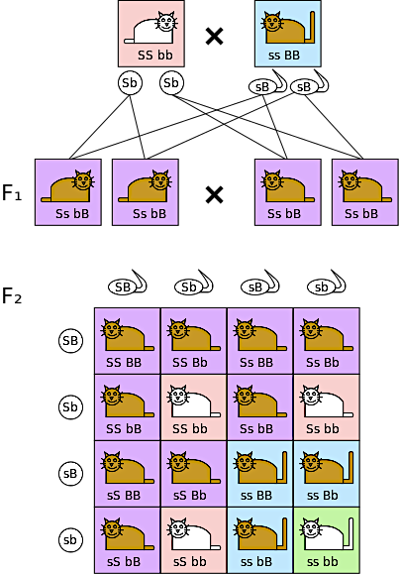
19
Which type of cross is demonstrated in this Punnett square?

Slide 21
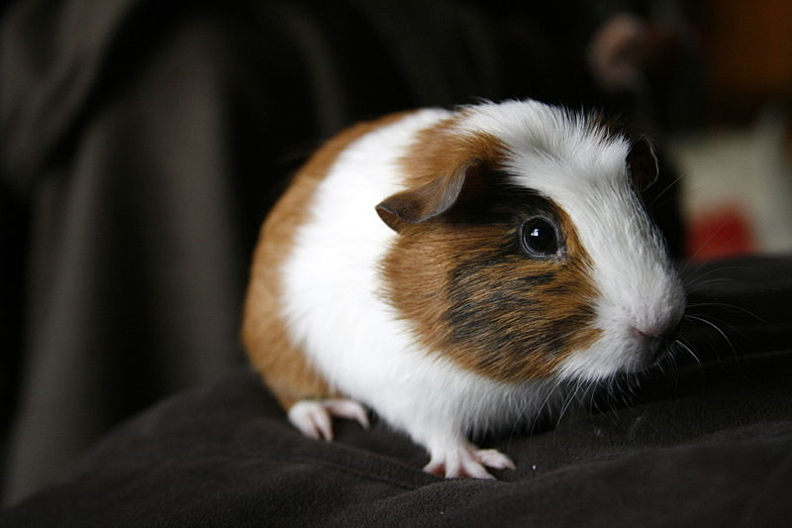
20
In guinea pigs, the allele S for short hair is dominant over the allele s for long hair. Also, the allele B for black hair is dominant over the allele b for brown hair.
Which ratio of offspring are expected to be short haired and brown from a cross of two guinea pigs that are both heterozygous for each trait?

Slide 22
21
Describe the difference in phenotypes between organisms that exhibit incomplete dominance for a trait vs. organisms that exhibit codominance for a trait.

Slide 23
22
Hair texture typically is incompletely dominant, and can be curly (C), straight (S) or wavy (SC).
Construct a Punnett square crossing a curly-haired parent with a wavy-haired parent.
Determine all phenotypic and genotypic ratios of the potential offspring.

Slide 24
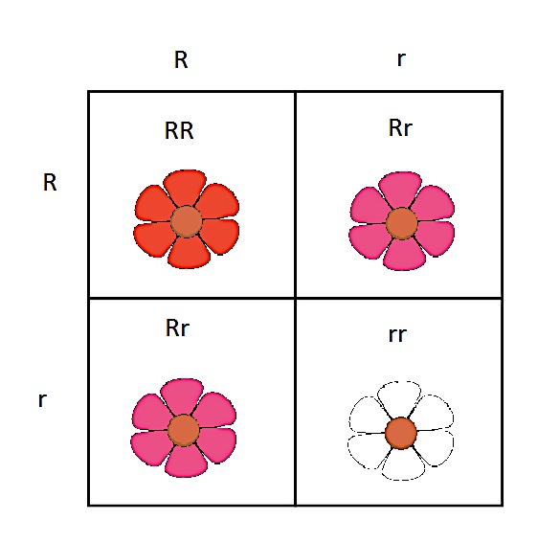
23
Which pattern of inheritance is depicted in the Punnett square?

Slide 25
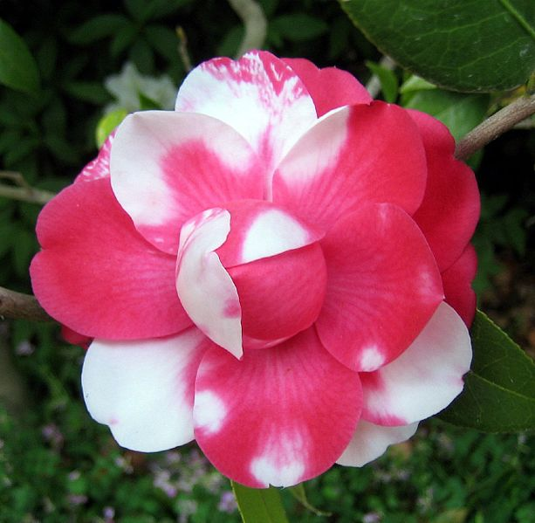
24
The rhododendron pictured here exhibits which of inheritance pattern for the flower petal color?

Slide 26
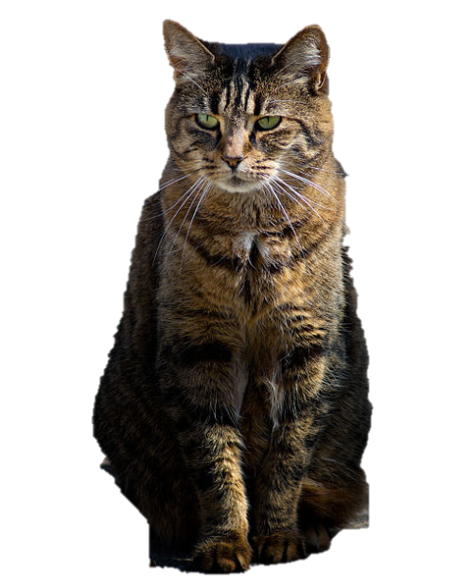
25
A cross between a black cat and a tan cat produces a tabby pattern (black and tan fur together).
List all the possible phenotypes and in what ratios from a cross between a tabby cat and a black cat.

Slide 27
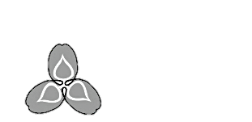
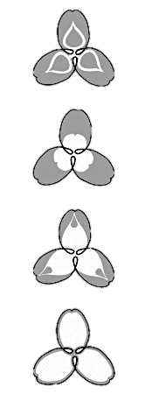
26
Plant 1 Plant 2
Plant 1 is homozygous for the chevron allele. Plant 2 is homozygous for the oval allele. The chevron and oval alleles are codominant.
If plant 1 and plant 2 are crossed, the codominance of the alleles will most likely result in which of the following leaf patterns on the offspring plants?
A B C D

Slide 28
27
In humans, there are 3 alleles for blood types: A, B and O. A and B are codominant, resulting in a third blood type, AB. The O blood type is recessive.
If a man who is heterozygous for type B blood marries a woman who has type AB blood, which blood type would their child most likely be?

