Slide 1
DNA and Protein Synthesis TEST Whiteboard Review
Please get out your amino acid sequencing map before the review starts.

Slide 6
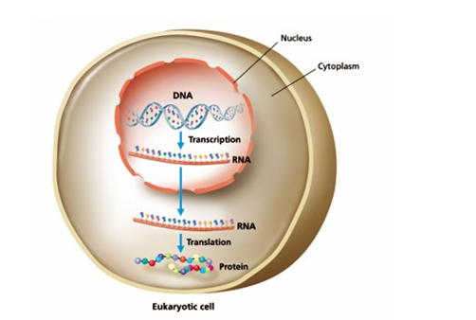
What is the name for the ultimate goal in this picture?

Slide 7
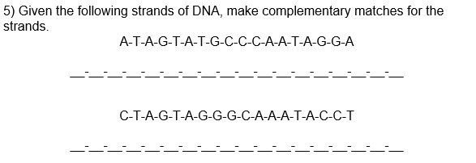

Slide 9
Give the name of each figure and what its function is.

Slide 22
